Slide 1
Causal Machine Learning
6.2091 Lecture 8

Slide 2
Logistics
Clarifications added to PSET 3 (problem 1.2, part d/e)
PSET 3 due Friday 2/2 at 11:59 pm EST
Study session Wednesday 5:30-7:30 pm EST 24-115 (this room)
Paper for Thursday: “On Causal and Anticausal Learning” by Schoelkopf et al. (Test of Time award at ICML 2022)

Slide 3
Causality can help solve open problems in ML
Out-of-distribution generalization
Fairness
Adversarial Robustness
Multi-task learning
Reinforcement learning
Etc….
[1] Schölkopf, Bernhard, et al. "Toward causal representation learning." Proceedings of the IEEE

Slide 4
Causality can help solve open problems ML
Out-of-distribution generalization
Fairness
Adversarial Robustness
Multi-task learning
Reinforcement learning
Etc….
[1] Schölkopf, Bernhard, et al. "Toward causal representation learning." Proceedings of the IEEE

Slide 5
Out-of-distribution (OOD) Generalization

Slide 6
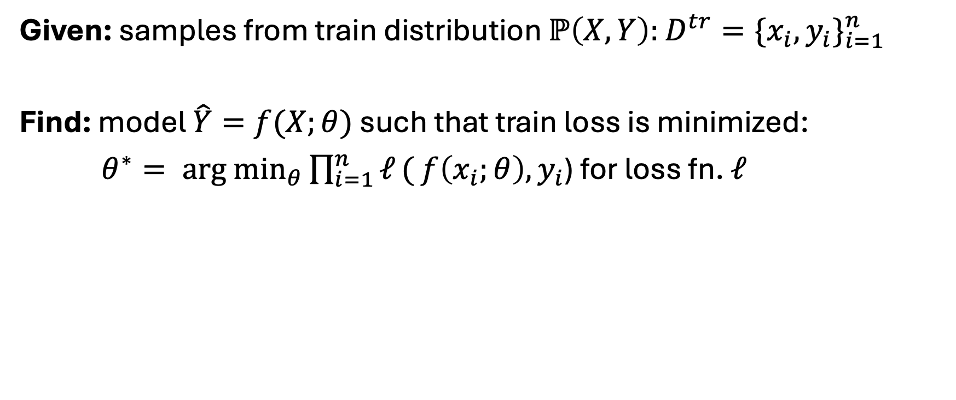
Supervised Machine Learning
Given: samples from train distribution $ℙ\left(X, Y\right):$ $D^{tr}=\{x_{i}, y_{i}\}_{i=1}^{n}$
Find: model $\hat{Y}=f(X;θ)$ such that train loss is minimized:
$θ^{∗}= \underset{θ}{arg min}{\prod_{i=1}^{n}{ℓ}(}$ $f\left(x_{i};θ\right),y_{i}$) for loss fn. $ℓ$

Slide 7
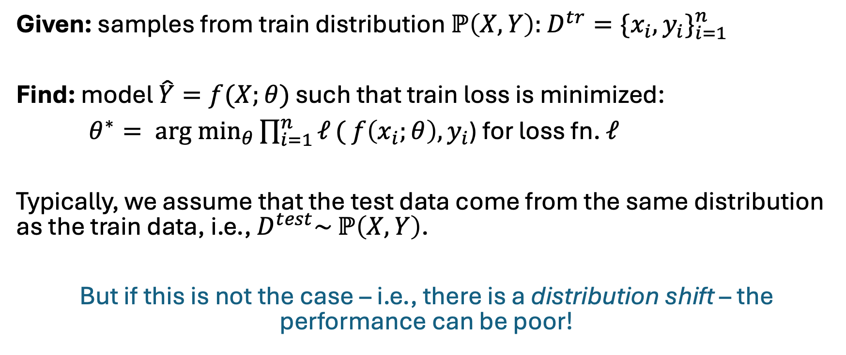
Supervised Machine Learning
Given: samples from train distribution $ℙ\left(X, Y\right):$ $D^{tr}=\{x_{i}, y_{i}\}_{i=1}^{n}$
Find: model $\hat{Y}=f(X;θ)$ such that train loss is minimized:
$θ^{∗}= \underset{θ}{arg min}{\prod_{i=1}^{n}{ℓ}(}$ $f\left(x_{i};θ\right),y_{i}$) for loss fn. $ℓ$
Typically, we assume that the test data come from the same distribution as the train data, i.e., $D^{test}\sim$ $ℙ\left(X, Y\right)$.
But if this is not the case – i.e., there is a distribution shift – the performance can be poor!

Slide 8
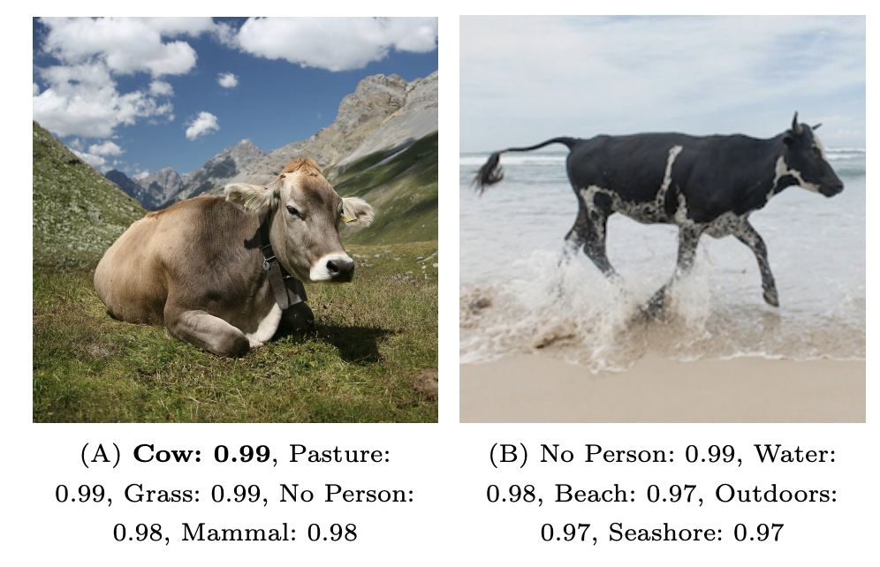
ML models can perform poorly OOD
Model fails to recognize animals in contexts that are uncommon in training data.
[2] Beery, Sara, Grant Van Horn, and Pietro Perona. "Recognition in terra incognita." Proceedings of the European conference on computer vision (ECCV). 2018.

Slide 9
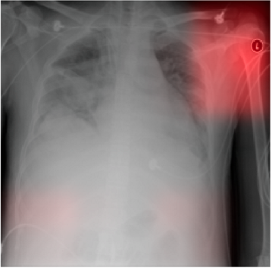
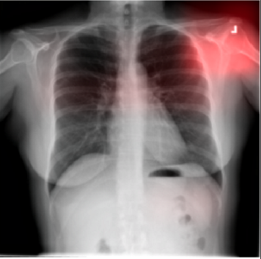
ML models can perform poorly OOD
Model underperforms at pneumonia detection in unseen hospitals.
[3] Zech, John R., et al. "Variable generalization performance of a deep learning model to detect pneumonia in chest radiographs: a cross-sectional study." PLoS medicine.

Slide 10
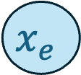
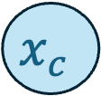
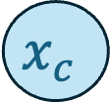



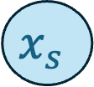
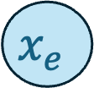
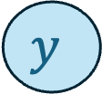
How can causality help?
Distribution Shift Intervention
$$x_{c}$$
$$x_{s}$$
$$x_{c}$$
$$x_{s}$$
$$ζ^{I}$$
$$y$$
$$y$$
$$x_{e}$$
$$x_{e}$$
Train
Test

Slide 11
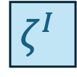
How can causality help?
Distribution Shift Intervention
animal
scene
animal
scene
$$ζ^{I}$$
Train: animal and scene are highly correlated.
Test: intervention breaks correlation.
label
label
Train
Test
$$ℙ\left(label | scene\right) ≠ ℙ^{I}\left(label \right| scene)$$
Notes:
- originally large correlation between animal and scene, so scene provides information about animal, which tells you something about the label
- under intervention scene and animal are not correlated, so knowing the scene doesn’t tell you anything about the label
Scene is not a reliable feature!

Slide 12

How can causality help?
Distribution Shift Intervention
animal
scene
animal
scene
$$ζ^{I}$$
Train: animal and scene are highly correlated.
Test: intervention breaks correlation.
label
label
Train
Test
$$ℙ\left(label | scene\right) ≠ ℙ^{I}\left(label \right| scene)$$
$$ℙ\left(label | animal\right) = ℙ^{I}\left(label \right| animal)$$
by consistency!
Notes:
Two ways to think about this
- originally large correlation between animal and scene, so scene provides information about animal, which tells you something about the label
- under intervention scene and animal are not correlated, so knowing the scene doesn’t tell you anything about the label
Scene is not a reliable feature!

Slide 13
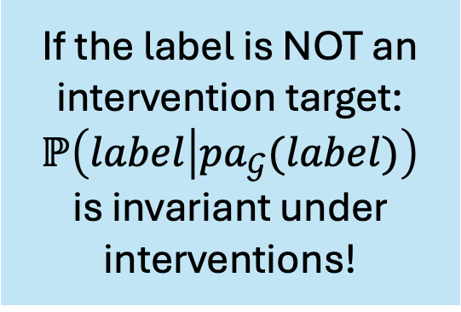
How can causality help?
If the label is NOT an intervention target: $ℙ\left(label | pa_{𝒢}(label)\right)$
is invariant under interventions!
Distribution Shift Intervention
animal
scene
animal
scene
$$ζ^{I}$$
label
label
Train
Test
$$ℙ\left(label | animal\right) = ℙ^{I}\left(label \right| animal)$$
by consistency!

Slide 14
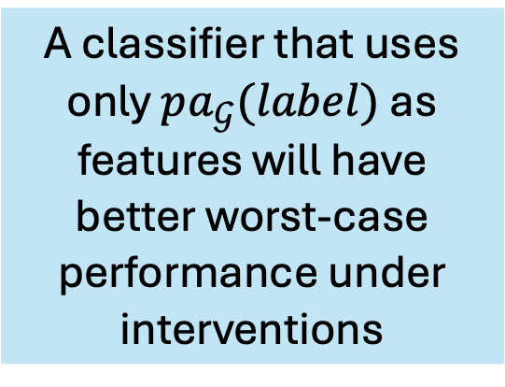
How can causality help?
If the label is NOT an intervention target: $ℙ\left(label | pa_{𝒢}(label)\right)$
is invariant under interventions!
Distribution Shift Intervention
animal
scene
animal
scene
$$ζ^{I}$$
A classifier that uses only $pa_{𝒢}(label)$ as features will have better worst-case performance under interventions
label
label
Train
Test
$$ℙ\left(label | animal\right) = ℙ^{I}\left(label \right| animal)$$
by consistency!

Slide 15
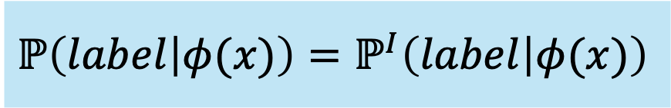
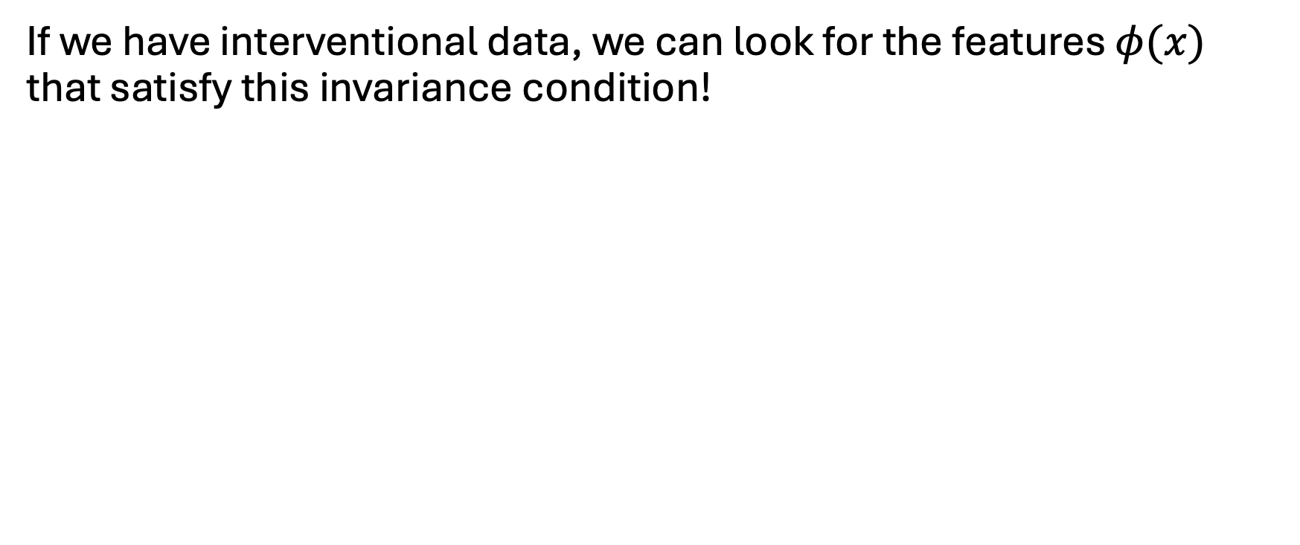
How can we find the causal parents?
If we have interventional data, we can look for the features $φ(x)$ that satisfy this invariance condition!
$$ℙ\left(label | φ(x)\right)=ℙ^{I}\left(label | φ(x)\right)$$

Slide 16
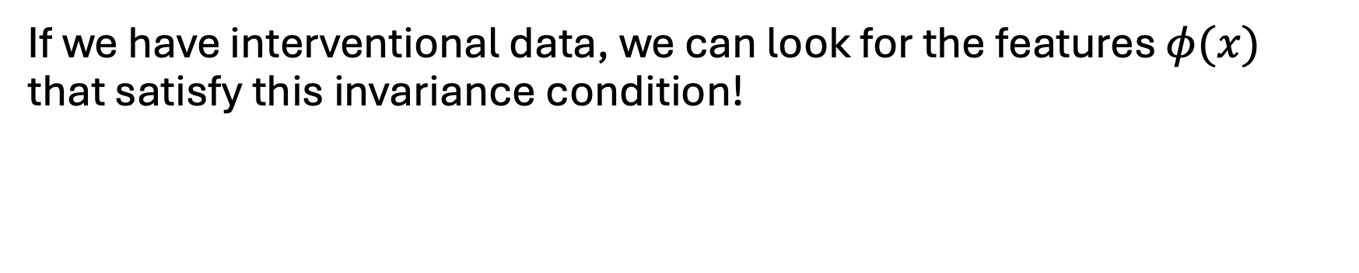
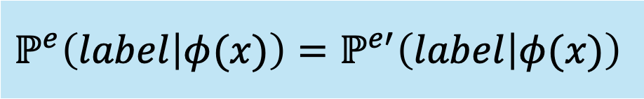
How can we find the causal parents?
If we have interventional data, we can look for the features $φ(x)$ that satisfy this invariance condition!
$$ℙ\left(label | φ(x)\right)=ℙ^{I}\left(label | φ(x)\right)$$
Can accomplish this with multi-environment data:
$$ℙ^{e}\left(label | φ(x)\right)=ℙ^{e′}\left(label | φ(x)\right)$$
Notes:
Environments may be different locations, times, policies, people, etc. (hospitals in healthcare setting)

Slide 17
Algorithms for finding invariant features
Invariant Causal Prediction (ICP) [Peters, et al. 2015] [4]
Goal: causal inference
Method: exhaustive search + statistical hypothesis tests
Invariant Risk Minimization (IRM) [Arjovsky, et al. 2019] [5]
Goal: OOD Generalization / Machine Learning
Method: gradient-based optimization

Slide 18
Algorithms for finding invariant features
Invariant Causal Prediction (ICP) [Peters, et al. 2015] [4]
Goal: causal inference
Method: exhaustive search + statistical hypothesis tests
Invariant Risk Minimization (IRM) [Arjovsky, et al. 2019] [5]
Goal: OOD Generalization / Machine Learning
Method: gradient-based optimization

Slide 19
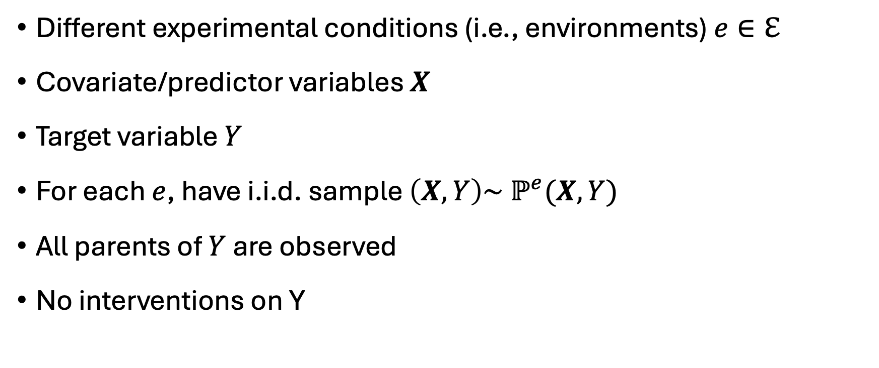
ICP | Problem Setup
Different experimental conditions (i.e., environments) $e∈ℇ$
Covariate/predictor variables $X$
Target variable $Y$
For each $e$, have i.i.d. sample $\left(X, Y\right)\sim ℙ^{e}(X, Y)$
All parents of $Y$ are observed
No interventions on Y
[6] Slides adapted from talk by Jonas Peters

Slide 20
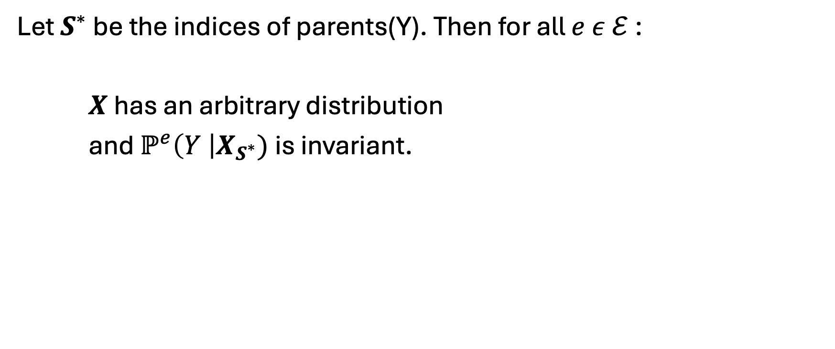
ICP | Invariance Assumption
Let $S^{∗}$ be the indices of parents(Y). Then for all $e ε ℰ$:
$X$ has an arbitrary distribution
and $ℙ^{e}\left(Y \right|X_{S^{∗}})$is invariant.
[6] Slides adapted from talk by Jonas Peters

Slide 21
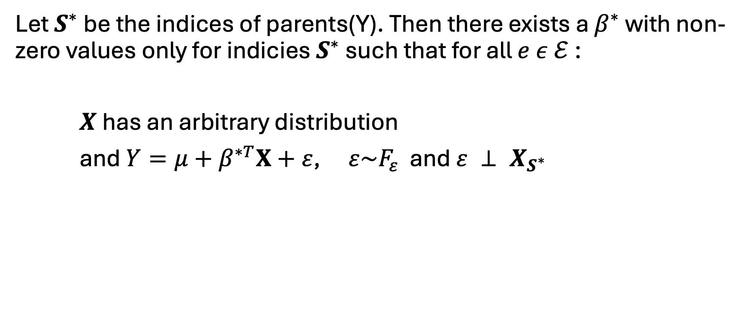
ICP | Invariance Assumption
Focus on linear setting!
Let $S^{∗}$ be the indices of parents(Y). Then there exists a $β^{∗}$ with non-zero values only for indicies $S^{∗}$ such that for all $e ε ℰ$:
$X$ has an arbitrary distribution
and $Y={μ+β}^{∗T}X+ε$,$ε\sim F_{ε}$ and $ε ⊥ X_{S^{∗}}$
[6] Slides adapted from talk by Jonas Peters

Slide 22
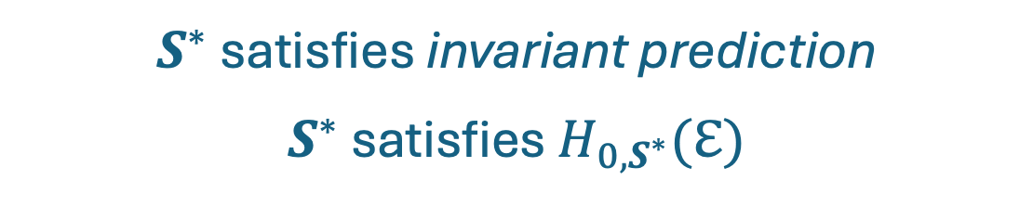
ICP | Invariance Assumption
Focus on linear setting!
Let $S^{∗}$ be the indices of parents(Y). Then there exists a $β^{∗}$ with non-zero values only for indicies $S^{∗}$ such that for all $e ε ℰ$:
$X$ has an arbitrary distribution
and $Y={μ+β}^{∗T}X+ε$,$ε\sim F_{ε}$ and $ε ⊥ X_{S^{∗}}$
$S^{∗}$ satisfies invariant prediction
$S^{∗}$ satisfies $H_{0,S^{∗}}(ℇ)$
[6] Slides adapted from talk by Jonas Peters

Slide 23
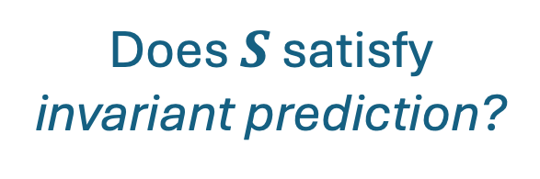
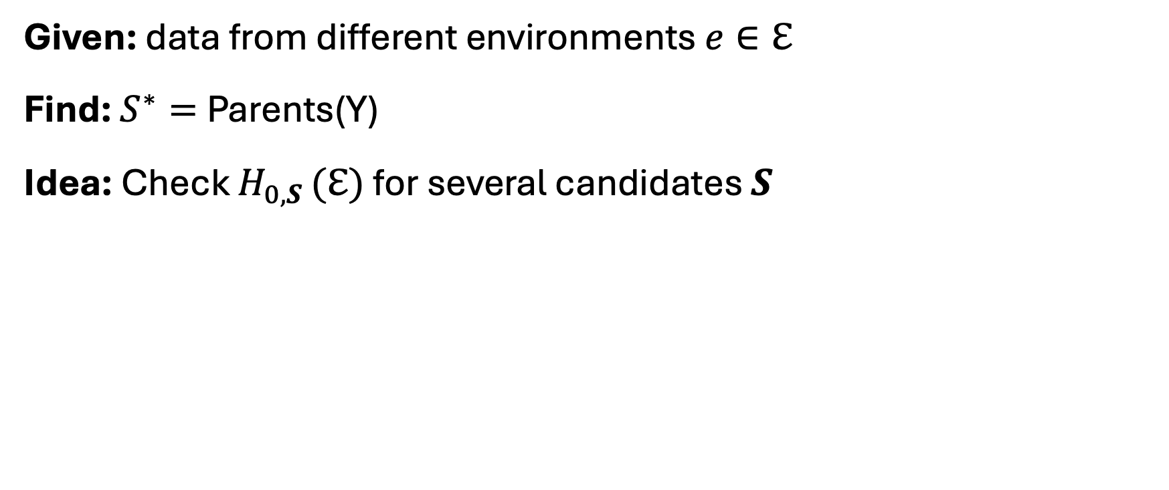
ICP | Objective
Given: data from different environments $e∈ℇ$
Find: $S^{∗}=$Parents(Y)
Idea: Check $H_{0,S }(ℇ)$ for several candidates $S$
Does $S$ satisfy invariant prediction?
[6] Slides adapted from talk by Jonas Peters

Slide 24
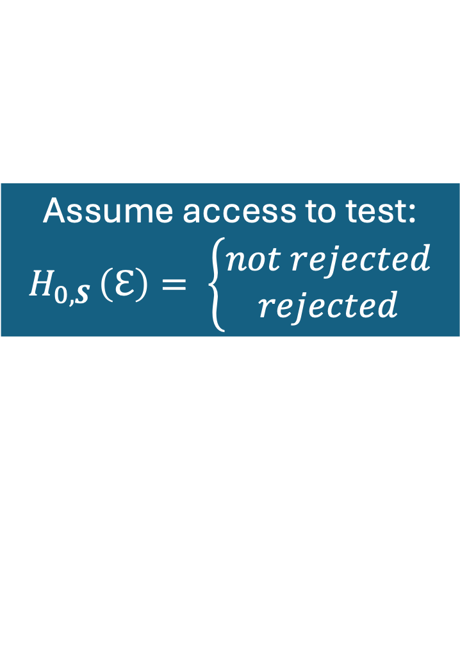
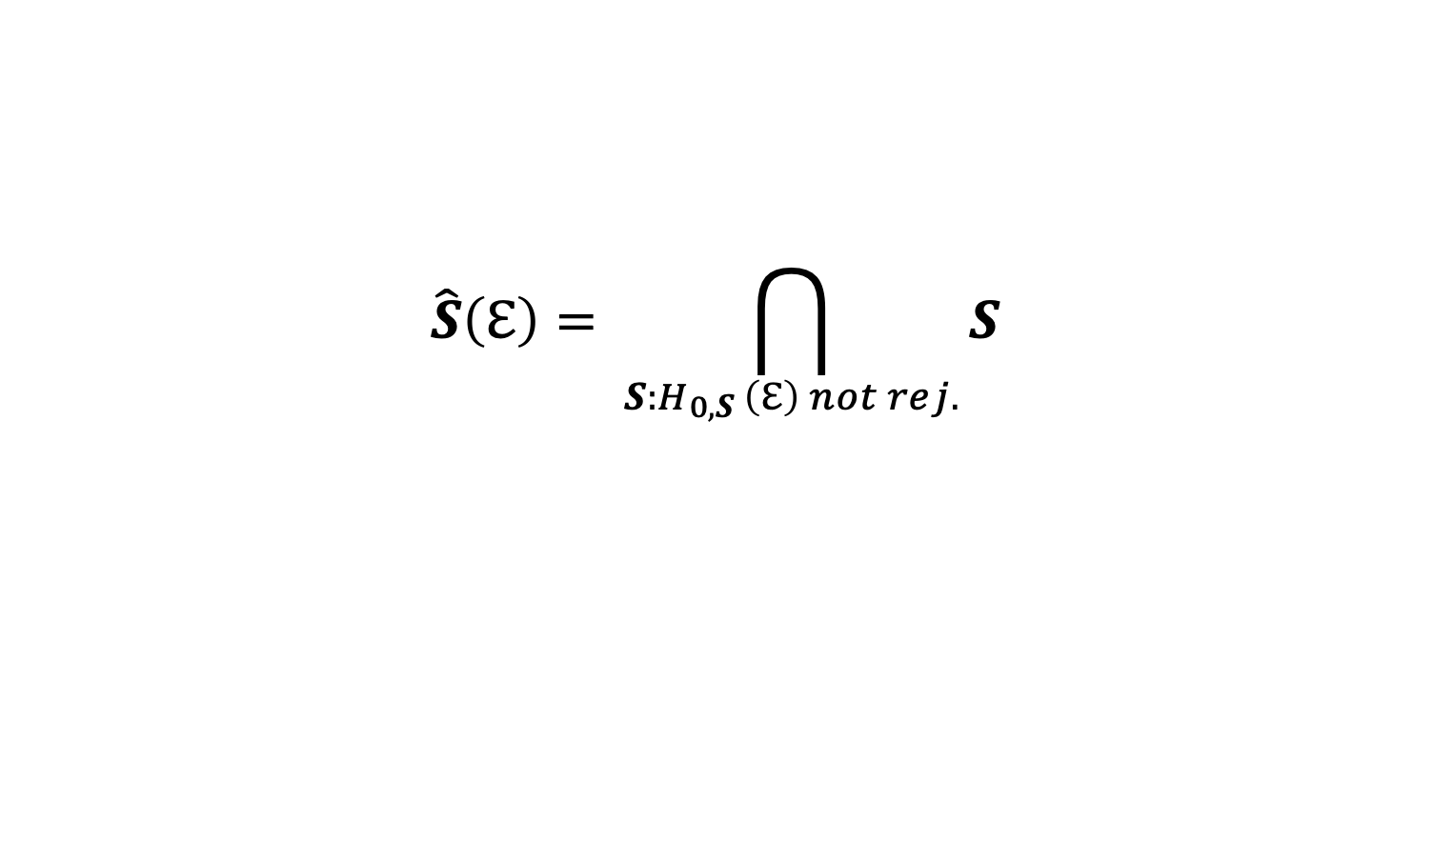
ICP | Algorithm
Assume access to test:
$H_{0,S }\left(ℇ\right)= \left\{\begin{aligned}not rejected \\ rejected\end{aligned}\right.$
$$\hat{S}\left(ℇ\right)= \bigcap_{S:H_{0,S }\left(ℇ\right) not rej.}{S}$$
[6] Slides adapted from talk by Jonas Peters

Slide 25

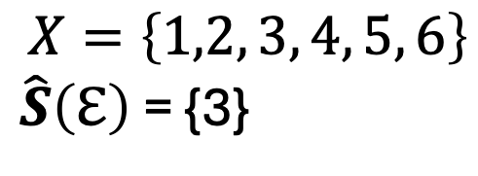
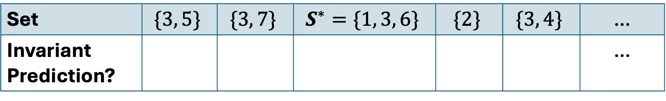
ICP | Algorithm
Assume access to test:
$H_{0,S }\left(ℇ\right)= \left\{\begin{aligned}not rejected \\ rejected\end{aligned}\right.$
$$\hat{S}\left(ℇ\right)= \bigcap_{S:H_{0,S }\left(ℇ\right) not rej.}{S}$$
Set | $$\{3, 5\}$$ | $$\{3, 7\}$$ | $$S^{∗}=\{1, 3, 6\}$$ | $$\{2\}$$ | $$\{3, 4\}$$ | …
Invariant Prediction? |  |  |  |  |  | …
$$X=\left\{1,2, 3, 4, 5, 6\right\}$$
$\hat{S}\left(ℇ\right)$ = {3}
[6] Slides adapted from talk by Jonas Peters

Slide 26
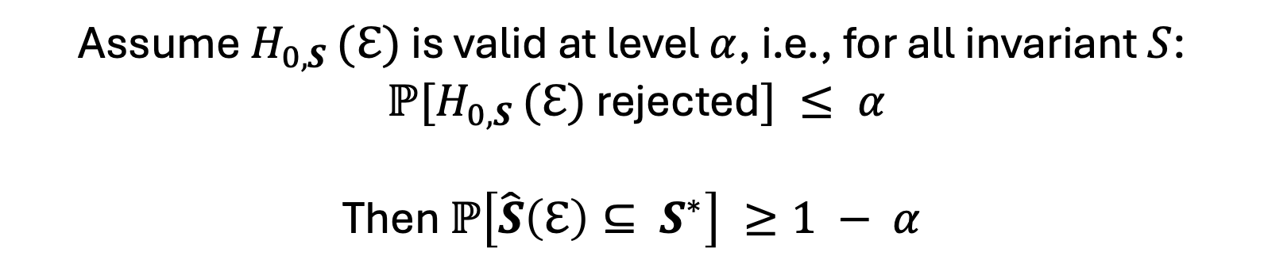
ICP | Algorithm
Assume access to test:
$H_{0,S }\left(ℇ\right)= \left\{\begin{aligned}not rejected \\ rejected\end{aligned}\right.$
$$\hat{S}\left(ℇ\right)= \bigcap_{S:H_{0,S }\left(ℇ\right) not rej.}{S}$$
Assume $H_{0,S }(ℇ)$ is valid at level $α$, i.e., for all invariant $S$:
$ℙ[H_{0,S }(ℇ)$ rejected$] ≤ α$
Then $ℙ\left[\hat{S}\left(ℇ\right)⊆ S^{∗}\right] ≥1 − α$
[6] Slides adapted from talk by Jonas Peters

Slide 27
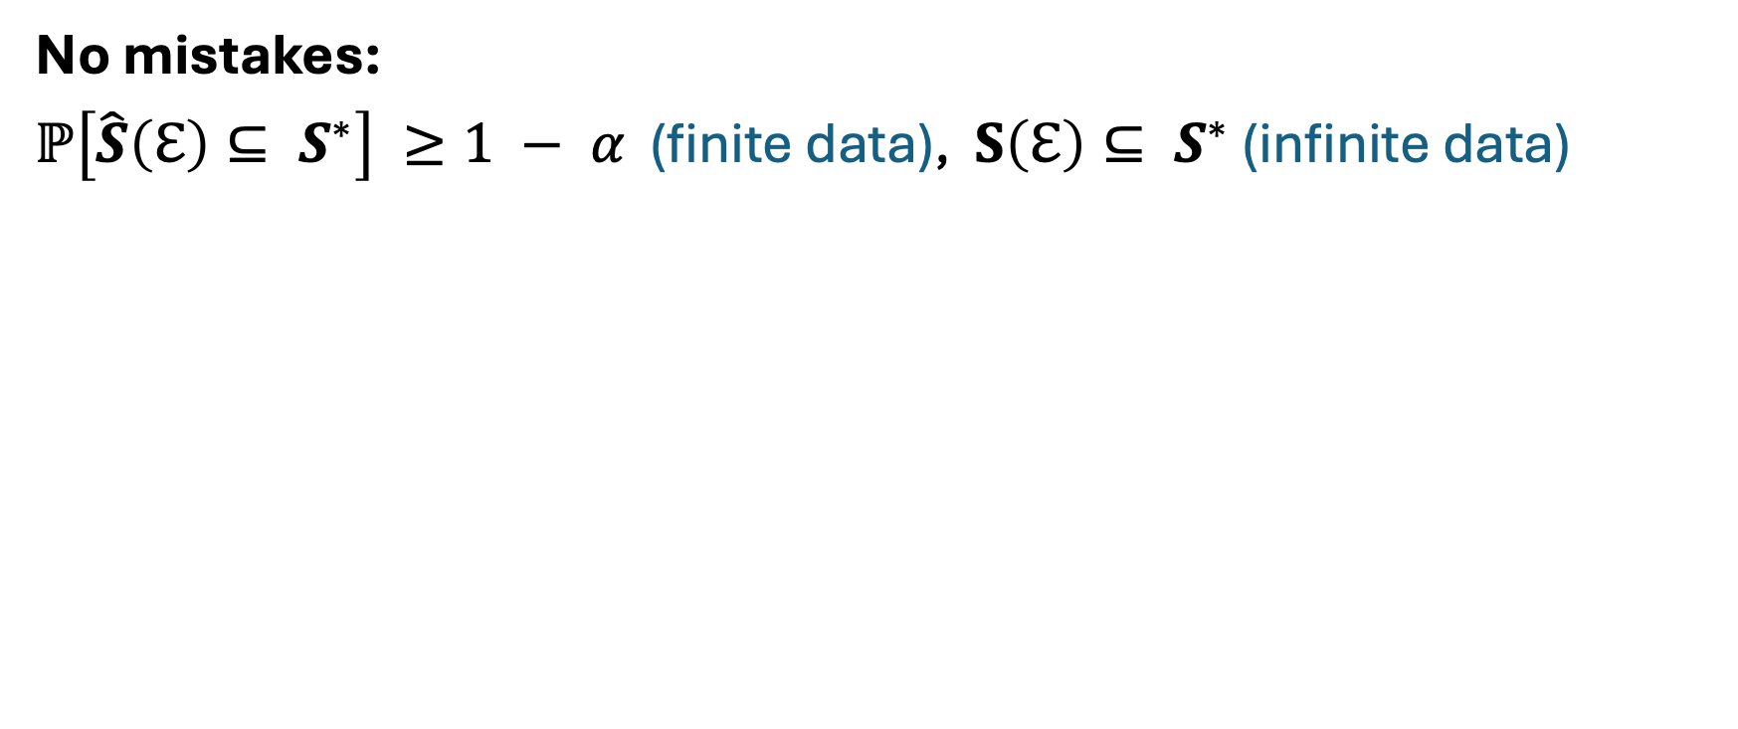
ICP | Properties
No mistakes:
$ℙ\left[\hat{S}\left(ℇ\right)⊆ S^{∗}\right] ≥1 − α$ (finite data), $S\left(ℇ\right)⊆ S^{∗}$ (infinite data)

Slide 28
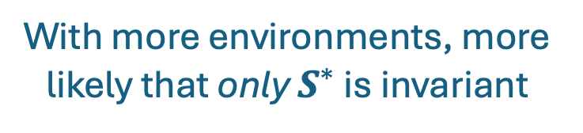
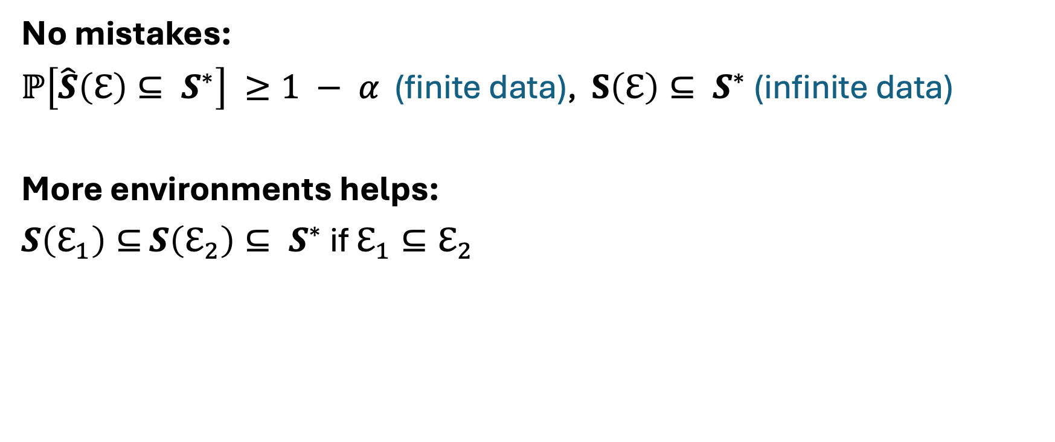
ICP | Properties
No mistakes:
$ℙ\left[\hat{S}\left(ℇ\right)⊆ S^{∗}\right] ≥1 − α$ (finite data), $S\left(ℇ\right)⊆ S^{∗}$ (infinite data)
More environments helps:
$S\left(ℇ_{1}\right)⊆$ $S\left(ℇ_{2}\right)⊆ S^{∗}$ if $ℇ_{1}⊆ℇ_{2}$
With more environments, more likely that only $S^{∗}$ is invariant

Slide 29
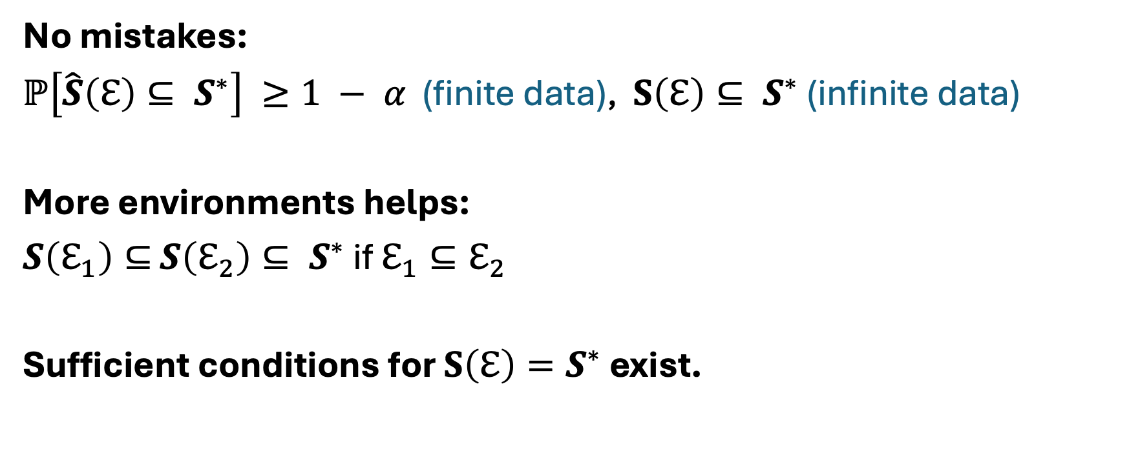
ICP | Properties
No mistakes:
$ℙ\left[\hat{S}\left(ℇ\right)⊆ S^{∗}\right] ≥1 − α$ (finite data), $S\left(ℇ\right)⊆ S^{∗}$ (infinite data)
More environments helps:
$S\left(ℇ_{1}\right)⊆$ $S\left(ℇ_{2}\right)⊆ S^{∗}$ if $ℇ_{1}⊆ℇ_{2}$
Sufficient conditions for $S\left(ℇ\right)=S^{∗}$ exist.
With more environments, more likely that only $S^{∗}$ is invariant
Identifiability improves with more/stronger interventions, at better places, and with more heterogeneity in the data.

Slide 30
Algorithms for finding invariant features
Invariant Causal Prediction (ICP) [Peters, et al. 2015] [4]
Goal: causal inference
Method: exhaustive search + statistical hypothesis tests
Invariant Risk Minimization (IRM) [Arjovsky, et al. 2019] [5]
Goal: OOD Generalization / Machine Learning
Method: gradient-based optimization

Slide 31
Algorithms for finding invariant features
Invariant Causal Prediction (ICP) [Peters, et al. 2015] [4]
Goal: causal inference
Method: exhaustive search + statistical hypothesis tests
Invariant Risk Minimization (IRM) [Arjovsky, et al. 2019] [5]
Goal: OOD Generalization / Machine Learning
Method: gradient-based optimization

Slide 32
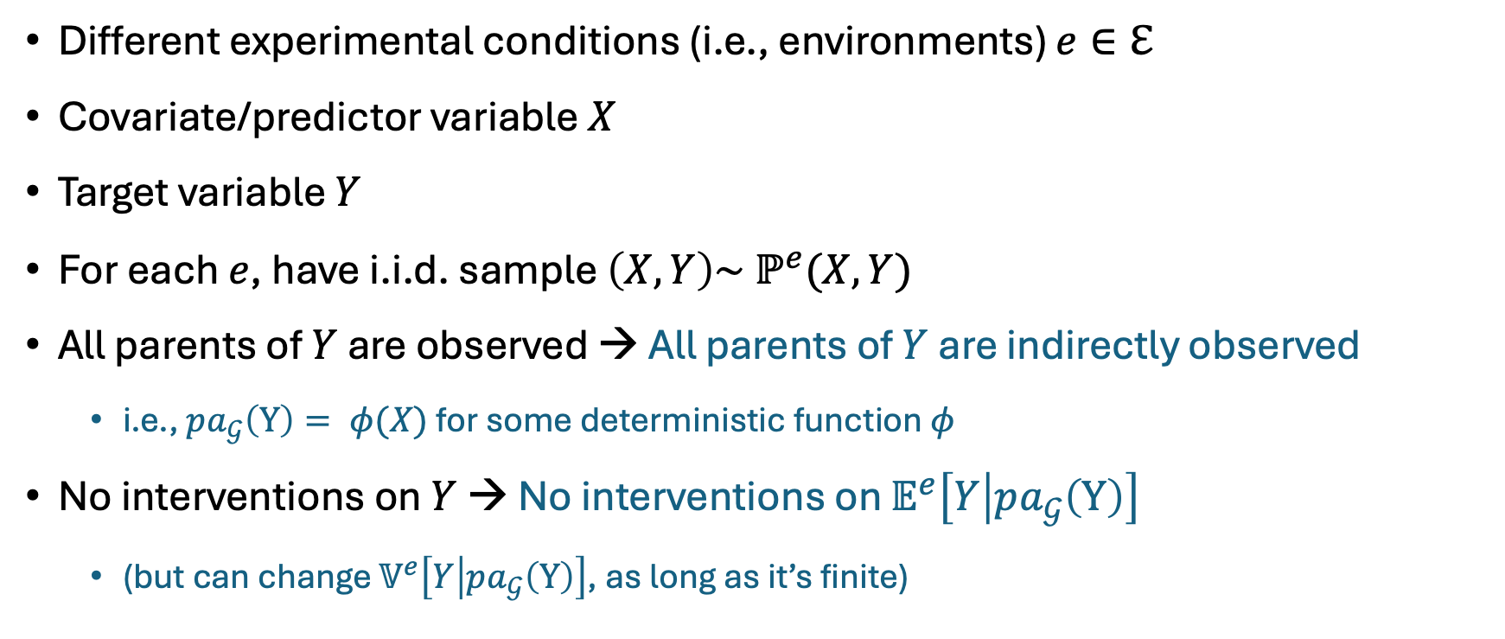
IRM | Problem Setup
Different experimental conditions (i.e., environments) $e∈ℇ$
Covariate/predictor variable $X$
Target variable $Y$
For each $e$, have i.i.d. sample $\left(X, Y\right)\sim ℙ^{e}(X, Y)$
All parents of $Y$ are observed → All parents of $Y$ are indirectly observed
i.e., $pa_{𝒢}\left(Y\right)= φ(X)$ for some deterministic function $φ$
No interventions on $Y$ → No interventions on $𝔼^{e}\left[Y | pa_{𝒢}\left(Y\right)\right]$
(but can change $𝕍^{e}\left[Y | pa_{𝒢}\left(Y\right)\right]$, as long as it’s finite)
Causal representation learning!

Slide 33
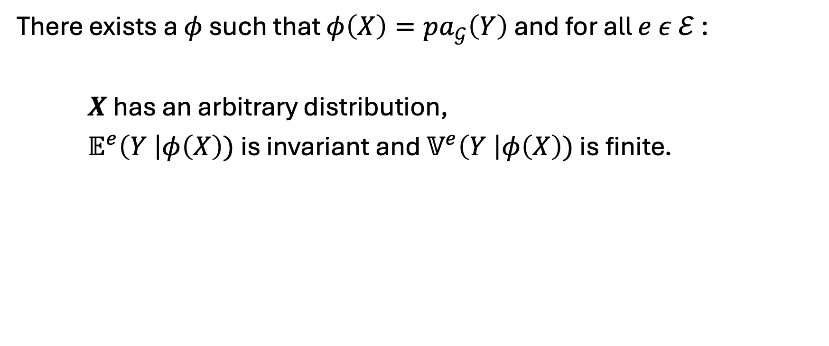
IRM | Invariance Assumption
There exists a $φ$ such that $φ\left(X\right)=pa_{𝒢}\left(Y\right)$ and for all $e ε ℰ$:
$X$ has an arbitrary distribution,
$𝔼^{e}\left(Y \right|φ\left(X\right))$is invariant and $𝕍^{e}\left(Y \right|φ\left(X\right))$ is finite.

Slide 34
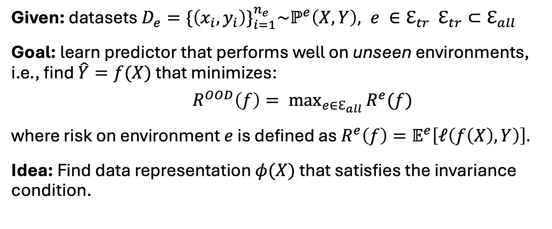
IRM | Objective
Given: datasets $D_{e}=\{\left(x_{i}, y_{i}\right)\}_{i=1}^{n_{e}}\sim ℙ^{e}\left(X, Y\right), {e ∈ℇ}_{tr}$ $ℇ_{tr}⊂ℇ_{all}$
Goal: learn predictor that performs well on unseen environments, i.e., find $\hat{Y}=f(X)$ that minimizes:
$R^{OOD}\left(f\right)= \max_{e∈ℇ_{all}}{R^{e}(f)}$
where risk on environment $e$ is defined as $R^{e}\left(f\right)=𝔼^{e}\left[ℓ\left(f\left(X\right), Y\right)\right].$
Idea: Find data representation $φ(X)$ that satisfies the invariance condition.

Slide 35

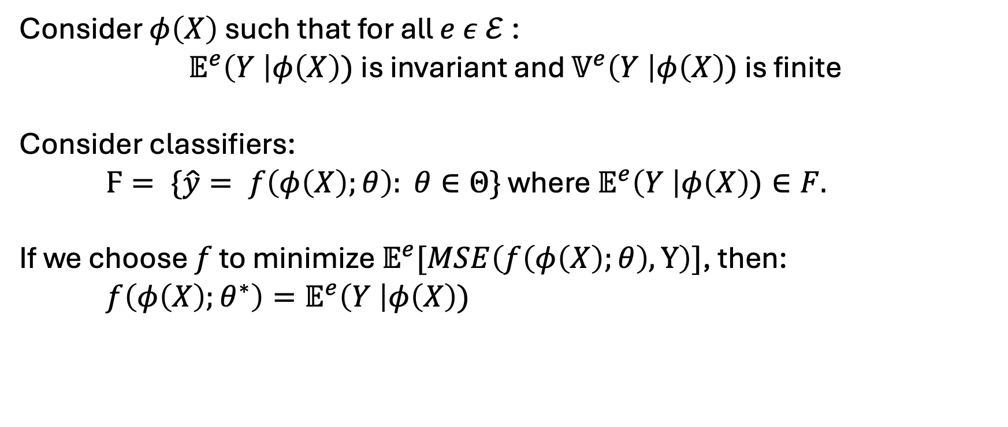
IRM | Invariance $↔$ OOD performance
Consider $φ\left(X\right)$ such that for all $e ε ℰ$:
$𝔼^{e}\left(Y \right|φ\left(X\right))$is invariant and $𝕍^{e}\left(Y \right|φ\left(X\right))$ is finite
Consider classifiers:
$Ϝ= \{\hat{y}= f\left(φ\left(X\right);θ\right): θ∈Θ\}$ where $𝔼^{e}\left(Y \right|φ\left(X\right))∈F.$
If we choose $f$ to minimize $𝔼^{e}[MSE\left(f\left(φ\left(X\right);θ\right), Y\right)]$, then:
$f\left(φ\left(X\right);θ^{∗}\right)=𝔼^{e}\left(Y \right|φ\left(X\right))$
the optimal classifier on top of $φ(X)$ is the same for all $e ε ℰ$!

Slide 36
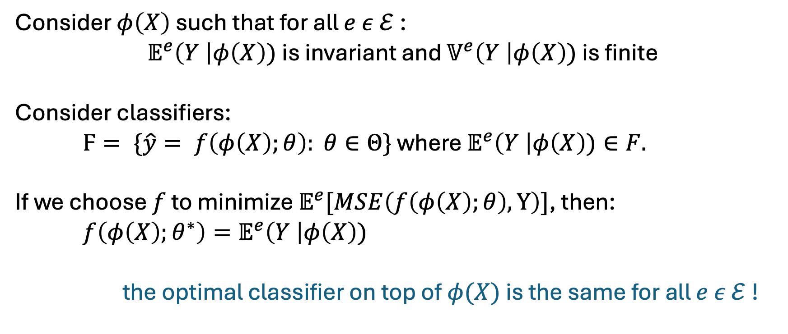
IRM | Invariance $↔$ OOD performance
Consider $φ\left(X\right)$ such that for all $e ε ℰ$:
$𝔼^{e}\left(Y \right|φ\left(X\right))$is invariant and $𝕍^{e}\left(Y \right|φ\left(X\right))$ is finite
Consider classifiers:
$Ϝ= \{\hat{y}= f\left(φ\left(X\right);θ\right): θ∈Θ\}$ where $𝔼^{e}\left(Y \right|φ\left(X\right))∈F.$
If we choose $f$ to minimize $𝔼^{e}[MSE\left(f\left(φ\left(X\right);θ\right), Y\right)]$, then:
$f\left(φ\left(X\right);θ^{∗}\right)=𝔼^{e}\left(Y \right|φ\left(X\right))$
the optimal classifier on top of $φ(X)$ is the same for all $e ε ℰ$!
the error of $f\left(φ\left(X\right);θ^{∗}\right)$ is finite for all $e ε ℰ$ (it is $𝕍^{e}\left(Y \right|φ\left(X\right))$ !

Slide 37
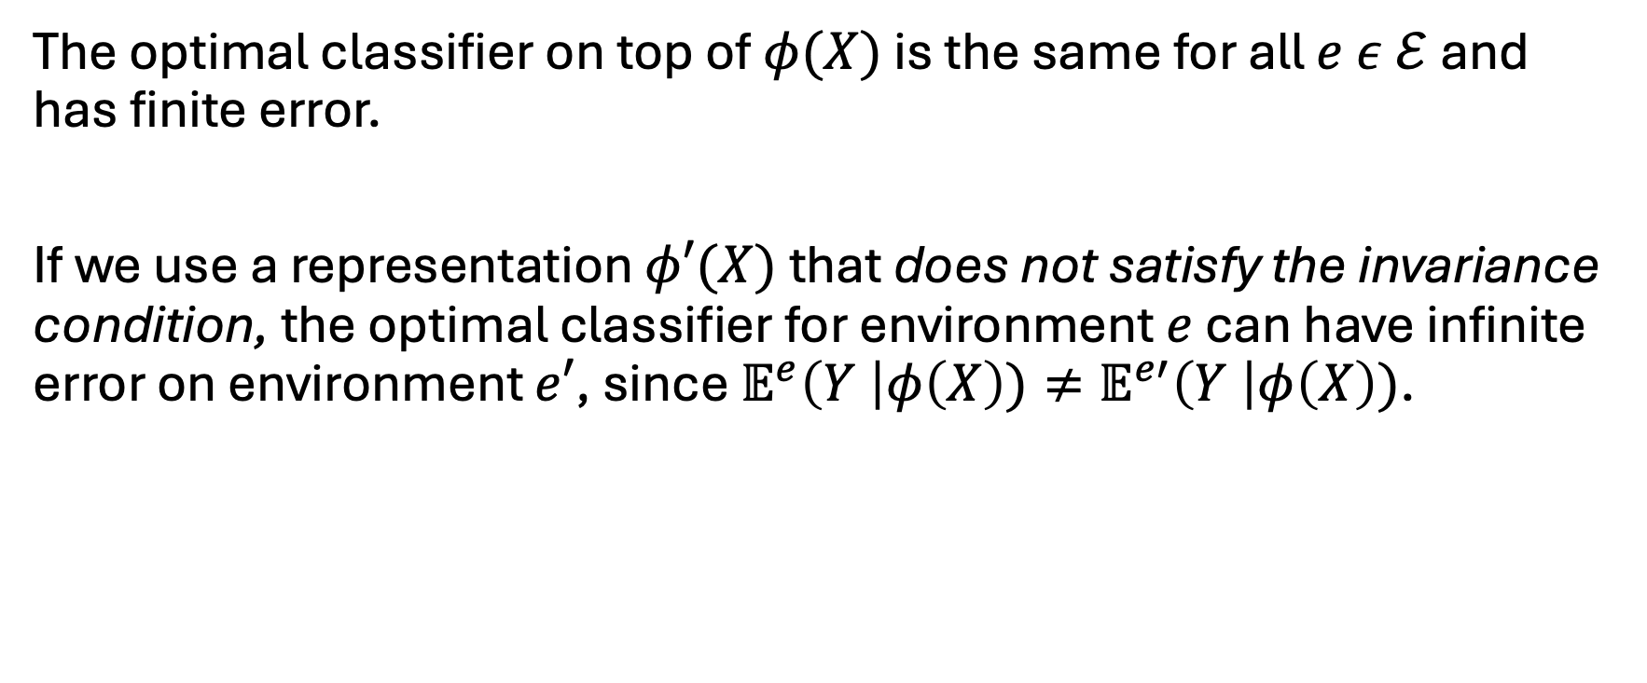
IRM | Invariance $↔$ OOD performance
The optimal classifier on top of $φ(X)$ is the same for all $e ε ℰ$and has finite error.
If we use a representation $φ′(X)$ that does not satisfy the invariance condition, the optimal classifier for environment $e$ can have infinite error on environment $e′$, since $𝔼^{e}\left(Y \right|φ\left(X\right))≠𝔼^{e′}\left(Y \right|φ\left(X\right))$.
Using $φ(X)$ minimizes the out-of-distribution error $R^{OOD}$!

Slide 38
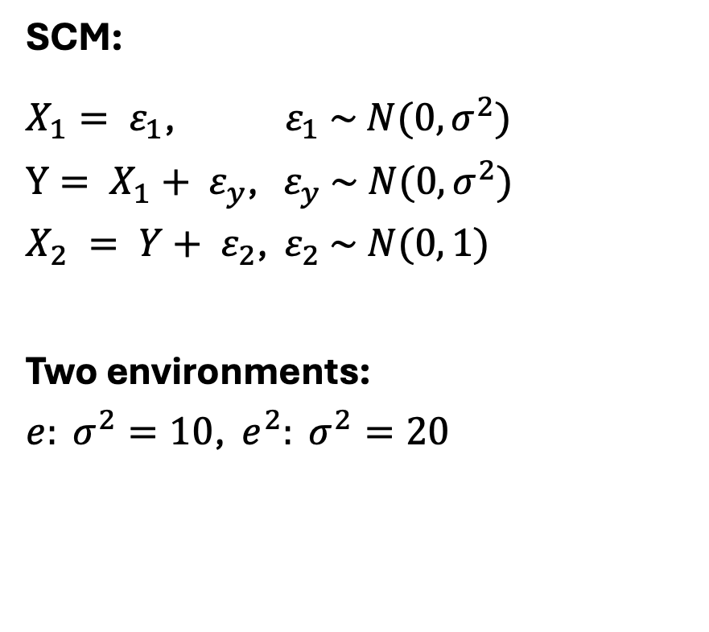
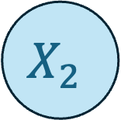
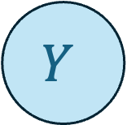
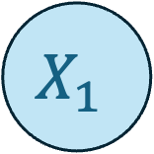
IRM | Example
$$X_{1}$$
SCM:
$X_{1}= ε_{1}$, ${ ε}_{1} \sim N(0, σ^{2})$
$Y= {X_{1}+ ε}_{y}$, $ε_{y} \sim N(0, σ^{2})$
$X_{2} = {Y+ ε}_{2}$, $ε_{2} \sim N(0, 1)$
Two environments:
$e: σ^{2}=10$, $e^{2}: σ^{2}=20$
$$Y$$
$$X_{2}$$

Slide 39
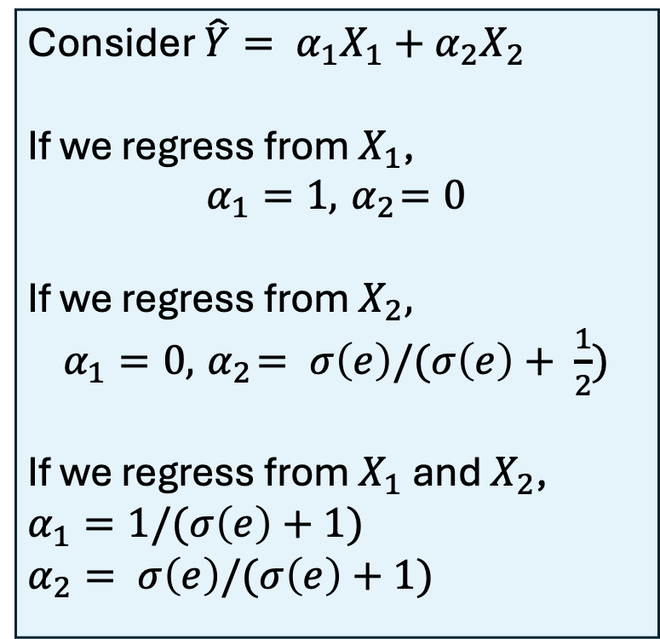
IRM | Example
$$X_{1}$$
SCM:
$X_{1}= ε_{1}$, ${ ε}_{1} \sim N(0, σ^{2})$
$Y= {X_{1}+ ε}_{y}$, $ε_{y} \sim N(0, σ^{2})$
$X_{2} = {Y+ ε}_{2}$, $ε_{2} \sim N(0, 1)$
Two environments:
$e: σ^{2}=10$, $e^{2}: σ^{2}=20$
Consider $\hat{Y}= α_{1}X_{1}+α_{2}X_{2}$
If we regress from $X_{1}$,
$$α_{1}=1, { α}_{2}=0$$
If we regress from $X_{2},$
$α_{1}=0, { α}_{2}= σ\left(e\right)/(σ\left(e\right)+ \frac{1}{2})$
If we regress from $X_{1}$ and $X_{2}$,
$α_{1}=1/(σ\left(e\right)+1)$
$α_{2}= σ\left(e\right)/(σ\left(e\right)+1)$
$$Y$$
$$X_{2}$$

Slide 40
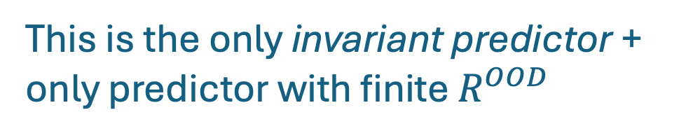
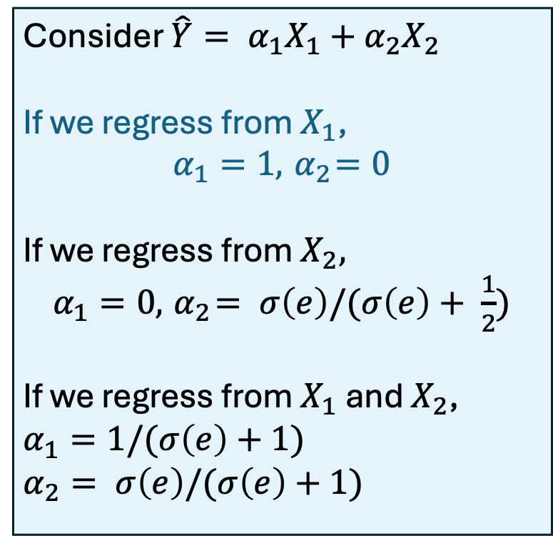
IRM | Example
This is the only invariant predictor + only predictor with finite $R^{OOD}$
$$X_{1}$$
SCM:
$X_{1}= ε_{1}$, ${ ε}_{1} \sim N(0, σ^{2})$
$Y= {X_{1}+ ε}_{y}$, $ε_{y} \sim N(0, σ^{2})$
$X_{2} = {Y+ ε}_{2}$, $ε_{2} \sim N(0, 1)$
Two environments:
$e: σ^{2}=10$, $e^{2}: σ^{2}=20$
Consider $\hat{Y}= α_{1}X_{1}+α_{2}X_{2}$
If we regress from $X_{1}$,
$$α_{1}=1, { α}_{2}=0$$
If we regress from $X_{2},$
$α_{1}=0, { α}_{2}= σ\left(e\right)/(σ\left(e\right)+ \frac{1}{2})$
If we regress from $X_{1}$ and $X_{2}$,
$α_{1}=1/(σ\left(e\right)+1)$
$α_{2}= σ\left(e\right)/(σ\left(e\right)+1)$
$$Y$$
$$X_{2}$$

Slide 41
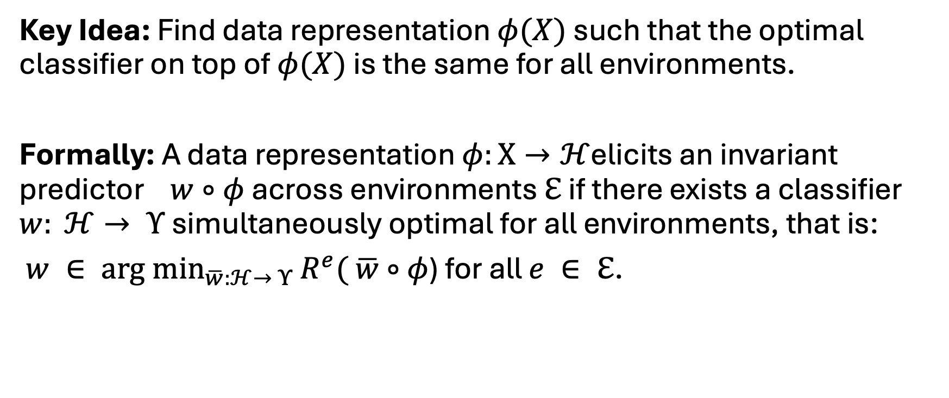
IRM | How to find invariant features?
Key Idea: Find data representation $φ(X)$ such that the optimal classifier on top of $φ(X)$ is the same for all environments.
Formally: A data representation $φ:Χ→ℋ$elicits an invariant predictor $w∘φ$ across environments $ℇ$ if there exists a classifier $w: ℋ→ Υ$ simultaneously optimal for all environments, that is:
$w ∈ \underset{\overline{w}:ℋ→ Υ}{arg min}{R^{e}(}$ $\overline{w}∘$ $φ$) for all $e ∈ ℇ$.

Slide 42
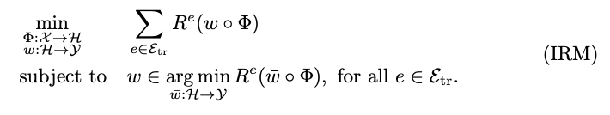
IRM | How to find invariant features?
Key Idea: Find best invariant predictor (i.e., minimizes train error).
Notes:
But this is a challenging, bi-level optimization problem, since each constraint calls an inner optimization routine
→ So instantiate into practical version

Slide 43
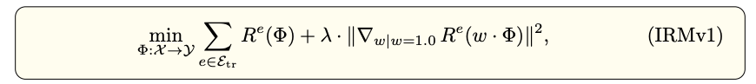
IRM | How to find invariant features?
Key Idea: Find best invariant predictor (i.e., minimizes train error).
Relaxed version:

Slide 44
IRM | How to find invariant features?
Minimize train error.
Invariance-based regularization.

Slide 45
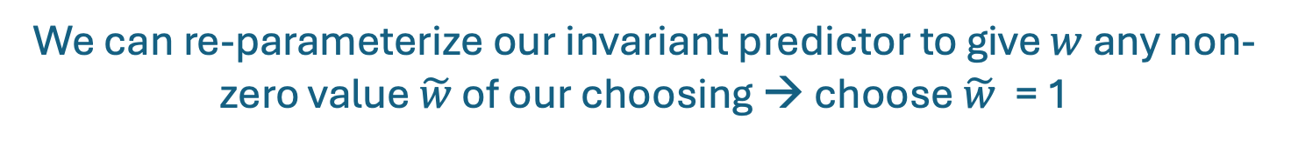



IRM | How to find invariant features?
Instead of searching for best $(w, φ)$, fix $w$ and search for best $φ$
Problem is overparameterized:
$$w∘ φ=\left(w∘ ψ^{−1}\right)∘(ψ∘φ)$$
$$\tilde{w}$$
$$\tilde{φ}$$
We can re-parameterize our invariant predictor to give $w$ any non-zero value $\tilde{w}$ of our choosing → choose $\tilde{w}$ = 1

Slide 46

IRM | How to find invariant features?
New goal: Find data representation $φ(X)$ such that the optimal classifier on top of $φ(X)$ is $w=1$ for all environments.

Slide 47

IRM | How to find invariant features?
New goal: Find data representation $φ(X)$ such that the optimal classifier on top of $φ(X)$ is $w=1$ for all environments.
If $w=1$ is the optimal classifier, then $∇_{w|w=1.0}R^{e}\left(w ∙φ\right)=0$.
Optimize this objective using stochastic gradient descent (SGD).

Slide 48
IRM | Issues
Theoretical
Very limited guarantees: assume linear setting + many environments
Existing work [7] shows that IRM fails with limited # environments and in non-linear settings with large distributions shifts
Empirical
Underperforms ERM (w/ rigorous hyperparameter tuning) on several domain generalization benchmarks [8]

Slide 49
Invariant Prediction: What else has been done?
Criticisms of IRM:
Rosenfeld, et al. "The risks of invariant risk minimization." ICLR (2021).
Kamath, Pritish, et al. "Does invariant risk minimization capture invariance?." AISTATS (2021).
Extensions of IRM:
Ahuja, Kartik, et al. "Invariant risk minimization games." ICML (2020).
Ahuja, Kartik, et al. "Invariance principle meets information bottleneck for out-of-distribution generalization.” NeurIPS (2021).
Extensions of ICP:
Heinze-Deml, Christina, Jonas Peters, and Nicolai Meinshausen. "Invariant causal prediction for nonlinear models." Journal of Causal Inference (2018)

Slide 50
Fairness

Slide 51
Counterfactual Fairness
Key idea: model decision is fair towards an individual if it is the same in (a) the actual world and (b) a counterfactual world in which they have a different sensitive attribute
Relevant Papers
Kusner, Matt J., et al. "Counterfactual fairness." NeurIPS (2017).
Coston, Amanda, et al. "Counterfactual risk assessments, evaluation, and fairness." FAACT (2020).

Slide 52
References

Slide 53
[1] Schölkopf, Bernhard, et al. "Toward causal representation learning." Proceedings of the IEEE
[2] Beery, Sara, Grant Van Horn, and Pietro Perona. "Recognition in terra incognita." Proceedings of the European conference on computer vision (ECCV). 2018.
[3] Zech, John R., et al. "Variable generalization performance of a deep learning model to detect pneumonia in chest radiographs: a cross-sectional study." PLoS medicine.
[4] Peters, Jonas, Peter Bühlmann, and Nicolai Meinshausen. "Causal inference by using invariant prediction: identification and confidence intervals." Journal of the Royal Statistical Society Series B: Statistical Methodology.
[5] Arjovsky, Martin, et al. "Invariant risk minimization." arXiv preprint arXiv:1907.02893 (2019).
[6] Jonas Peters, et al. ”RSS Ordinary Meeting - Causal inference by using invariant prediction”. https://www.youtube.com/watch?v=nvUkkAjSpKc.
[7] Rosenfeld, Elan, Pradeep Ravikumar, and Andrej Risteski. "The risks of invariant risk minimization." ICLR (2021).
[8] Gulrajani, Ishaan, and David Lopez-Paz. "In search of lost domain generalization." ICLR (2021).

